Slide 1
Housekeeping
Material for this workshop can be found at:
kelseyandersen.github.io/CC2.1Workshop19
Outline for this morning:
Introduction to R
Networks in R
Spreading in Networks

Slide 2


Introduction to R
garrettlab.com

Slide 3
Today’s Learning Objectives:
Become familiar (or re-familiarized) with:
The R and R studio interface;
Setting up your workspace and working directory;
Importing data;
Creating objects;
Loading packages;
Creating vectors;
Subsetting.

Slide 4

Recommended Resources
Swirlstats.com
Notes:
add links for r studio

Slide 5
Recommended Resources
http://r4ds.had.co.nz/

Slide 6
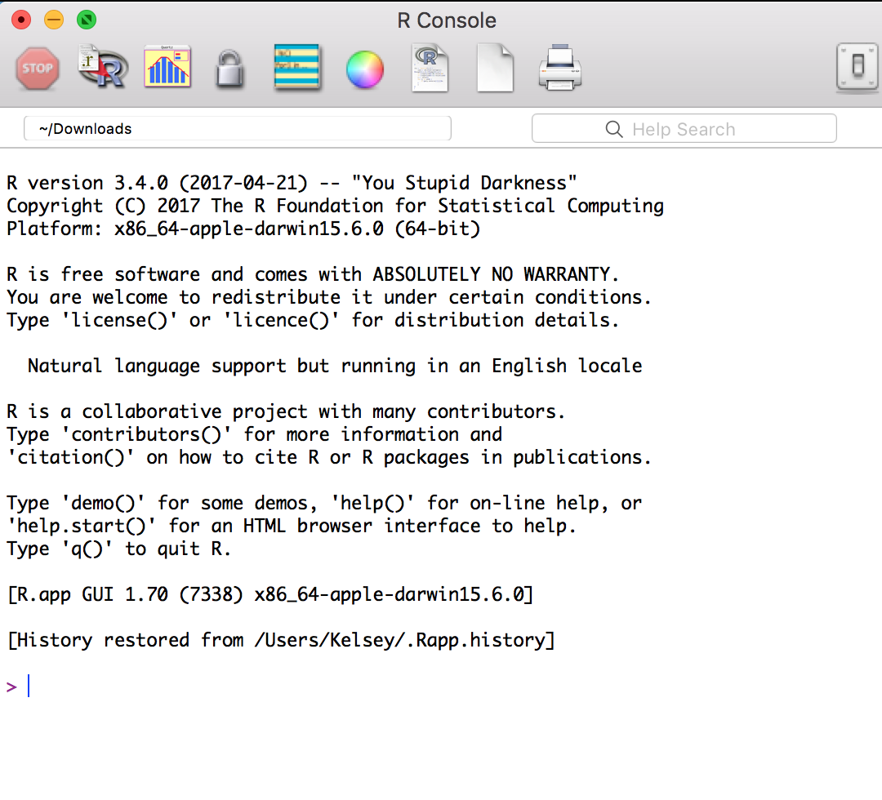
You need two programs installed:

Slide 7
The R Studio Workspace
Script editor (where you type and save your code)
Workspace-
view your data and objects
History
View what has already happened in this session
View Plots, Load Packages, Ask for help
Console (where you can see what happened to your code)

Slide 8
Now… for the fun stuff!
Some reasons why R is great:
R is a suite of tools that allows you to import, transform, visualize, and analyze your data!
As biologists, it’s our virtual laboratory, so good practices for using it are as important as good pipetting skills.
Get lazy with your pipetting now, you’ll pay for it later,
Get lazy with your data practices now… you get the idea.
R is an open source project that grew up with us, so there are tons of resources on google & blogs.
“google” any error and you’ll probably find a solution
Keep up to speed on new trends on r-bloggers.com

Slide 9
R Packages
You can do some basic calculations in base R but most things will be carried out in functions that are organized in packages.
Packages are collections of r functions, data, and code that are usually developed to help with a specific task.
There are over 10,000 packages on CRAN!
Some are more organized, with better documentation and quality control (some may be wrong)
Better to use well-known packages (such as those we will recommend)

Slide 10
Some packages that you will use in this course:
ggplot2
tidyverse
igraph
statnet
matrix
sna
ergm
tergm
dplyr

Slide 11
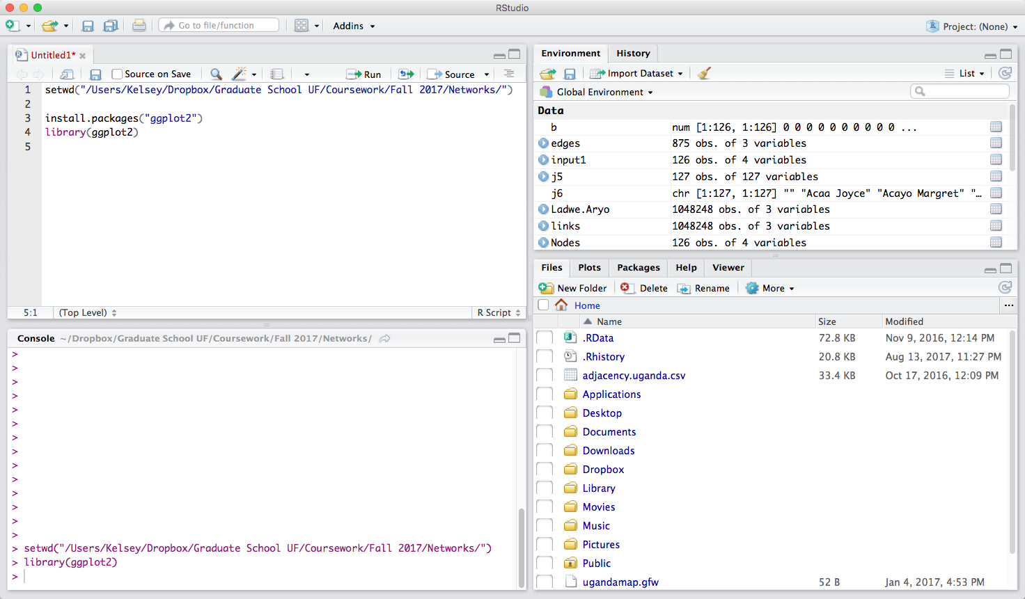
Let’s get to work!

